Slide 1

Styling
With CSS
#2 Layouting

Slide 2
CSS Variables
<head><style>
:root {
--merah: red;
--kuning: orange;
--hijau: greenyellow;
} h1 {color: var(--merah);}
h2 {color: var(--kuning);}
h3 {color: var(--hijau);}
</style></head><body>
<h1>Halo semuanya, apa kabar?</h1>
<h2>Halo semuanya, apa kabar?</h2>
<h3>Halo semuanya, apa kabar?</h3>
</body>

Slide 3
Grouping
<head><style>
h1, h2, p {
color: blueviolet;
font-family: Impact;
}
</style></head><body>
<h1>Contoh Grouping</h1>
<h2>Tiga elemen,</h2>
<p>Satu style.</p>
</body>

Slide 4
Descendant Selector
<head><style>
main h2 {
color: red;
font-family: Impact;
}
header h2, footer h2 {
color: green;
font-family: Arial;
}
</style></head><body>
<header><h2>Ini header</h2></header>
<main><h2>Ini konten</h2></main>
<footer><h2>Ini footer</h2></footer>
</body>

Slide 5
Child Selector
<head><style>
main > p {
color: red;
font-family: Impact;
font-size: 30px
}
</style></head><body>
<main>
<p>di dalam main</p>
<div>
<p>dalam div dalam main</p>
</div>
</main>
</body>

Slide 6
Child Selector
<head><style>
main > div > p {
color: red;
font-family: Impact;
font-size: 30px
}
</style></head><body>
<main>
<p>di dalam main</p>
<div>
<p>dalam div dalam main</p>
</div>
</main>
</body>

Slide 7
Adjacent Selector
<head><style>
h1 + p {
color: red;
font-family: Impact;
font-size: 30px
}
</style></head><body>
<h1>Ini header</h1>
<p>Ini paragraf 1</p>
<p>Ini paragraf 2</p>
<p>Ini paragraf 3</p>
</body>

Slide 8
Adjacent Selector
<head><style>
h1 + p + p {
color: red;
font-family: Impact;
font-size: 30px
}
</style></head><body>
<h1>Ini header</h1>
<p>Ini paragraf 1</p>
<p>Ini paragraf 2</p>
<p>Ini paragraf 3</p>
</body>

Slide 9
Pseudo-classes
Pseudo-classes are used to target specific states of an element. By adding it to your selector, you can style elements only if they're in the state you want them to be. This lesson will go through the most commonly-used ones.

Slide 10
Pseudo-classes
Links
<head><style>
a:visited {color: purple;}
a:link {color: red;}
</style></head><body>
<a href="#" target="_blank">
Lihat efek sebelum & sesudah diklik!
</a>
</body>

Slide 11
Pseudo-classes
Hover
<head><style>
h1{
text-align: center;
color: purple;
}
h1:hover {
color: white;
background-color: purple;
}
</style></head><body>
<h1>Purwadhika</h1>
</body>

Slide 12
Pseudo-classes
Focus
<head><style>
input:focus {
background-color: lightgreen;
}
</style></head>
<body>
<div><input type="number"/></div>
<br>
<div><input type="number"/></div>
<br>
<div><input type="number"/></div>
</body>

Slide 13
Pseudo-classes
Active
<head><style>
input:active {
background-color: lightgreen;
}
</style></head>
<body>
<div>
<input type="submit"/>
</div>
</body>

Slide 14
Pseudo-elements
Pseudo-elements are similar to pseudo-classes but instead of classes you can style right away, they are elements that you can target.

Slide 15
Pseudo-elements
Child
<head><style>
h2:first-child {
background-color: red;
}
h2:last-child {
background-color: green;
}
h2:nth-child(2) {
background-color: yellow;
}
</style></head><body>
<h2>Anak ke-1 ~ first-child!</h2>
<h2>Anak ke-2 ~ nth-child(2)</h2>
<h2>Anak ke-3 ~ last-child!</h2>
</body>

Slide 16
Pseudo-elements
Child
<head><style>
h2:nth-child(odd) {
background-color: yellow;
}
h2:nth-child(even) {
background-color: red;
}
</style></head><body>
<h2> Anak ke-1 </h2>
<h2> Anak ke-2 </h2>
<h2> Anak ke-3 </h2>
<h2> Anak ke-4 </h2>
<h2> Anak ke-5 </h2>
</body>

Slide 17
Pseudo-elements
Type
<head><style>
h2:nth-of-type(1) {
background-color: red;
}
h2:nth-of-type(2) {
background-color: green;
}
h2:nth-of-type(3) {
background-color: yellow;
}
</style></head><body>
<h2>nth-of-type(1)</h2>
<h2>nth-of-type(2)</h2>
<h2>nth-of-type(3)</h2>
</body>

Slide 18
Pseudo-elements
Type
<head><style>
h2:nth-of-type(odd) {
background-color: yellow;
}
h2:nth-of-type(even) {
background-color: red;
}
</style></head><body>
<h2> Anak ke-1 </h2>
<h2> Anak ke-2 </h2>
<h2> Anak ke-3 </h2>
<h2> Anak ke-4 </h2>
<h2> Anak ke-5 </h2>
</body>

Slide 19
Pseudo-elements
1st Letter & Line
<head><style>
p:first-letter {
font-size: 100px;
}
p:first-line {
color: red;
font-size: 50px
}
</style></head><body>
<p>Halo semuanya, apa kabar?</p>
</body>

Slide 20
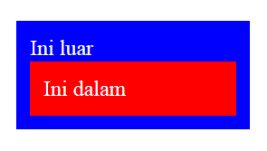
# Positioning
<head><style>
body {
padding: 10px; color: white;
}
.luar {
background-color: blue; padding: 10px;
}
.dalam {
background-color: red; padding: 10px;
}
</style></head><body>
<div class="luar">
Ini luar
<div class="dalam">
Ini dalam
</div>
</div>
</body>

Slide 21
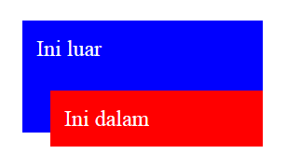
Relative Position
Relative to parent
<head><style>
body {
padding: 10px; color: white;
}
.luar {
background-color: blue; padding: 10px;
}
.dalam {
background-color: red; padding: 10px;
position: relative; top: 20px; left: 10px;
}
</style></head><body>
<div class="luar">
Ini luar
<div class="dalam">
Ini dalam
</div>
</div>
</body>

Slide 22
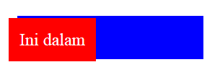
Absolute Position
Absolute to body
<head><style>
body {
padding: 10px; color: white;
}
.luar {
background-color: blue; padding: 10px;
}
.dalam {
background-color: red; padding: 10px;
position: absolute; top: 20px; left: 10px;
}
</style></head><body>
<div class="luar">
Ini luar
<div class="dalam">
Ini dalam
</div>
</div>
</body>

Slide 23
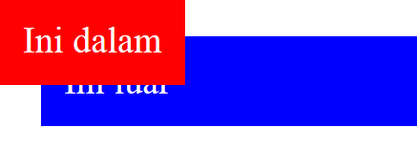
Fixed Position
<head><style>
body {
padding: 10px; color: white;
}
.luar {
background-color: blue; padding: 10px;
}
.dalam {
background-color: red; padding: 10px;
position: fixed; top: 0px; left: 0px;
}
</style></head><body>
<div class="luar">
Ini luar
<div class="dalam">
Ini dalam
</div>
</div>
</body>

Slide 24
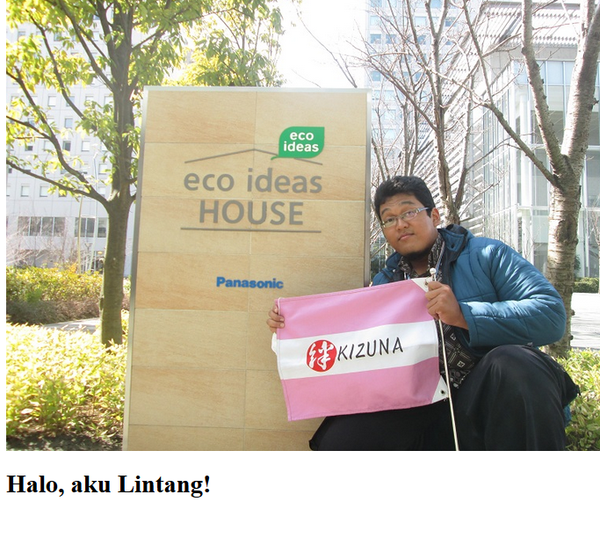
Float & Clear
<head><style> </style></head><body>
<div class="pic">
<img src="lin.jpg" />
</div>
<h1>Halo, aku Lintang!</h1>
</body>

Slide 25
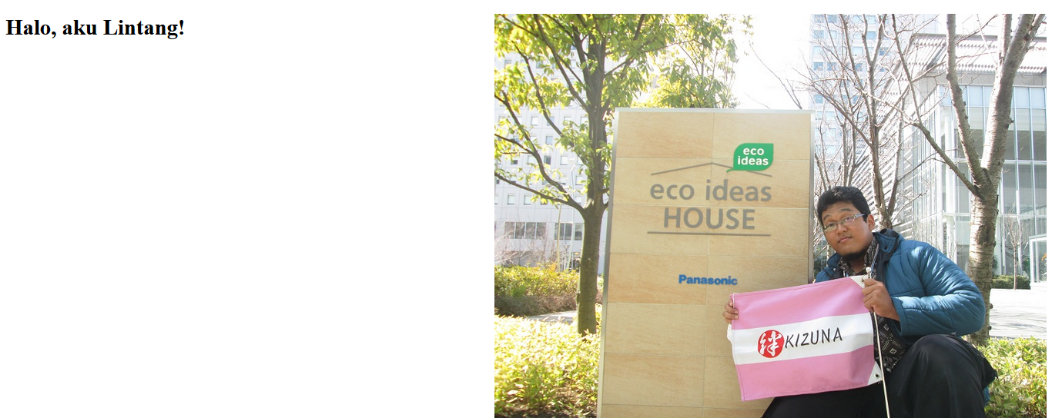
Float
<head><style>
.pic {
float: right;
}
</style></head><body>
<div class="pic">
<img src="lin.jpg" />
</div>
<h1>Halo, aku Lintang!</h1>
</body>

Slide 26
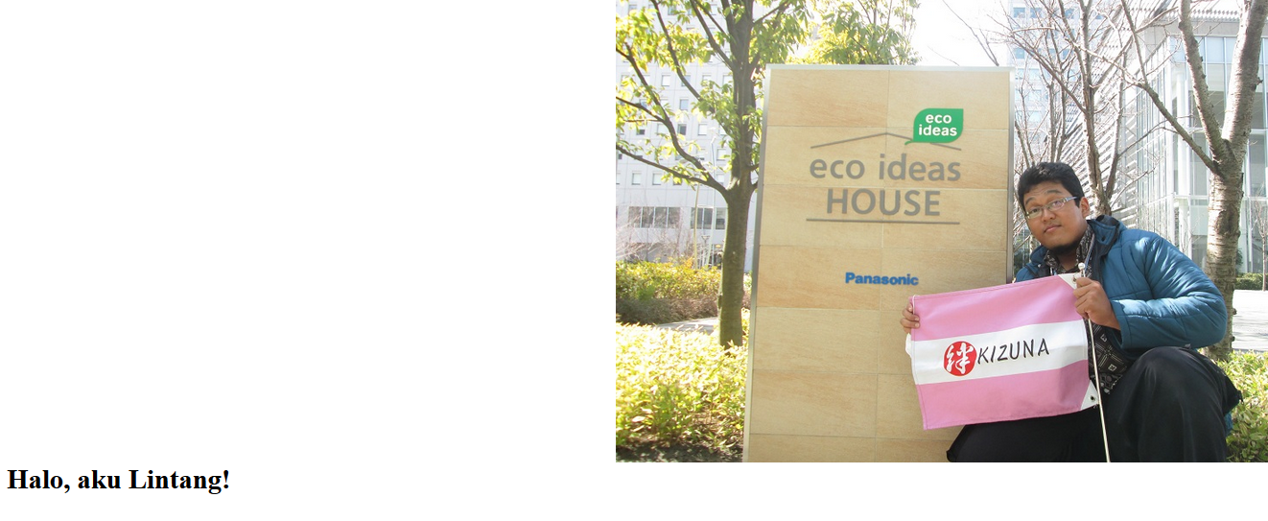
Clear
<head><style>
.pic {float: right;}
.text {clear: both;}
</style></head><body>
<div class="pic">
<img src="lin.jpg" />
</div>
<h1 class="text">Halo, aku Lintang!</h1>
</body>

Slide 27
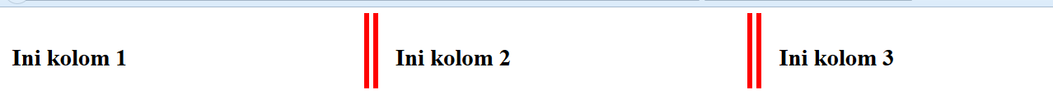
Columns
<head><style>
.kolom {
column-count: 3;
column-gap: 50px;
column-rule: 20px double red;
}
</style></head><body>
<main class="kolom">
<br><h1>Ini kolom 1</h1>
<br><h1>Ini kolom 2</h1>
<br><h1>Ini kolom 3</h1>
</main>
</body>

Slide 28
Import
<head><style>
@import url('css/1.css');
</style></head>
<body>
<h1>Halo Dunia!</h1>
</body>
h1 {
color: blueviolet;
background-color: yellow;
}
1.html
css/1.css

Slide 29
Media Query
Print
<head><style>
@media print {
body {
font-size: 1250%;
}
}
</style></head>
<body>
<p>Halo Dunia!</p>
</body>
// Print this page!

Slide 30
Media Query
Screen Size
<head><style>
@media screen and (min-width: 600px) {
body {
background-color: blue;
}
}
@media screen and (max-width: 600px) {
body {
background-color: red;
}
}
@media screen and (min-width: 900px) {
body {
background-color: greenyellow;
}
}
</style></head><body></body>

Slide 31
Transition
<head><style>
body {
transition: 1s;
height: 500px;
background-color: yellow;
}
body:hover {
background-color: black;
}
</style></head>
<body>
</body>

Slide 32
Transition
Property
<head><style>
.box {
transition: height 1s;
height: 100px;
width: 200px;
background-color: red;
} .box:hover {
height: 200px;
background-color: blue;
}
</style></head>
<body>
<div class="box"></div>
</body>

Slide 33
Transition
Delay
<head><style>
.box {
transition: height 1s 2000ms;
height: 100px;
width: 200px;
background-color: red;
} .box:hover {
height: 200px;
background-color: blue;
}
</style></head>
<body>
<div class="box"></div>
</body>

Slide 34
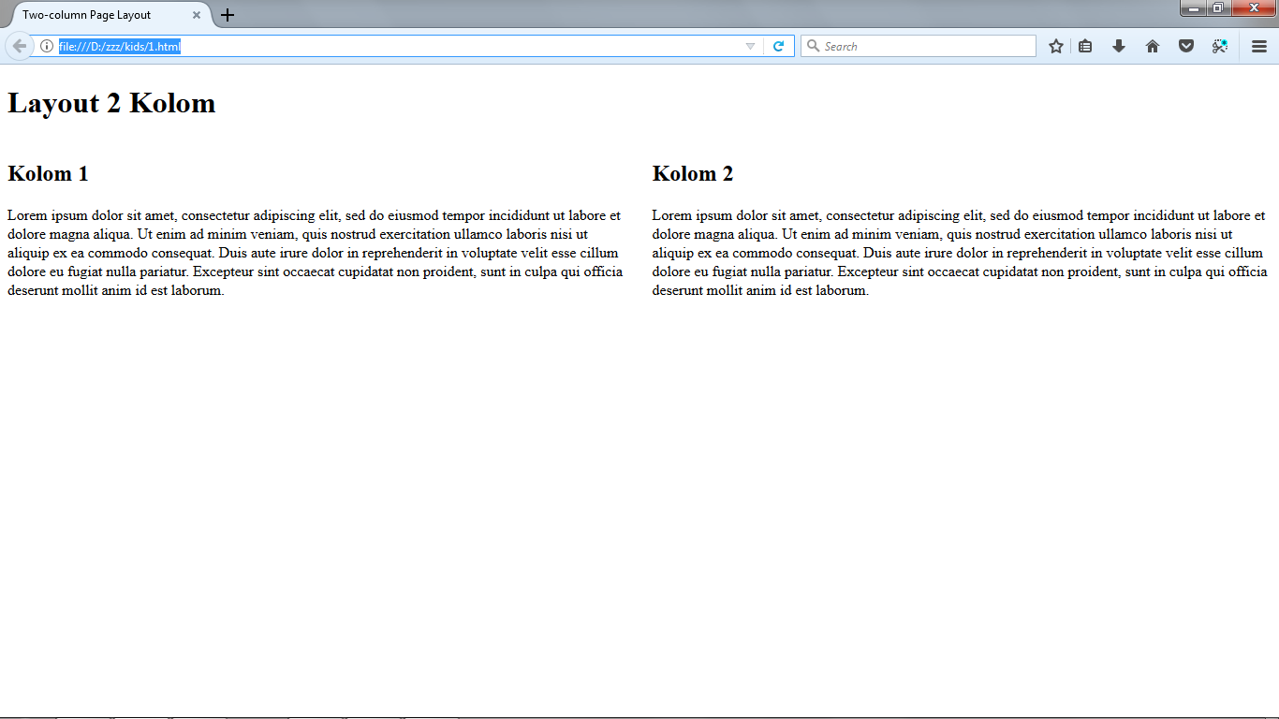
2-Columns Page Layout

Slide 35
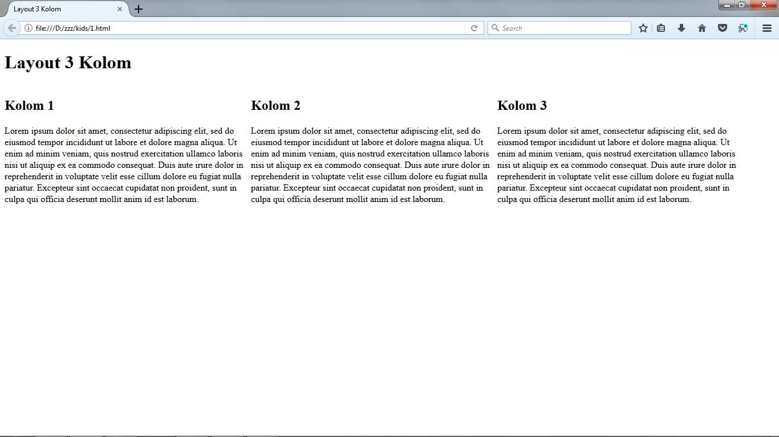
3-Columns Page Layout

Slide 36
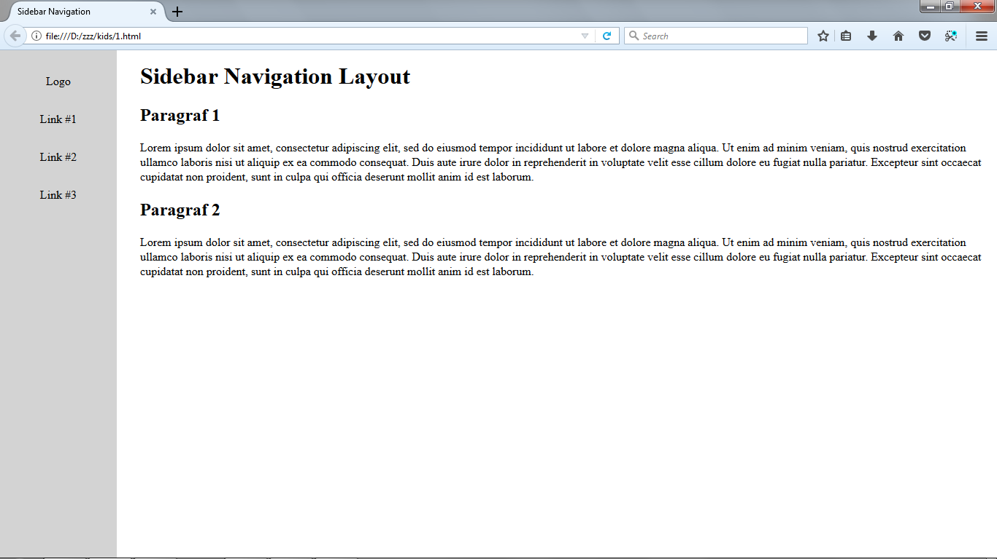
Sidebar Navigation Layout

Slide 37
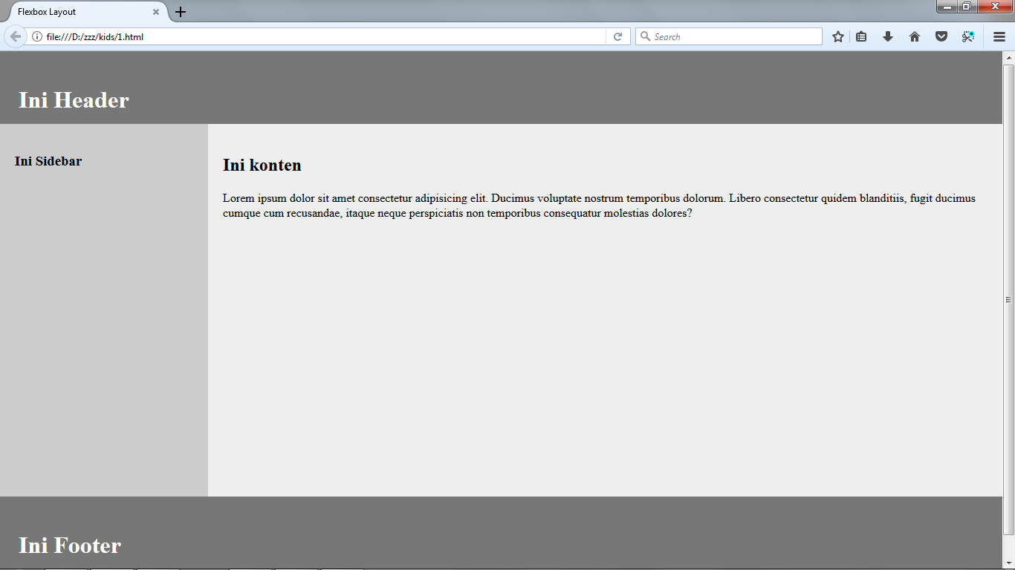
Flexbox Layout

Slide 38
Styling
With CSS
#2 Layouting

